Slide 1

Android Fragments
CIS 399

Slide 2
Course Overview
Wk | Topic
1 | Intro, single-screen apps
1 | Activity Lifecycle, saving activity state
2 | Layouts + widgets, Event Handlers
2 | Themes + styles, Menu + settings
2 | Multi-screen apps, Fragments
Wk | Topic
3 | Reading XML files, Asynch Tasks
3 | List Views
3 | SQLite Database
4 | Consuming a web service
4 | Geolocation

Slide 3
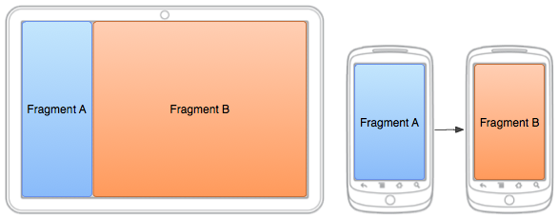
Fragment Concepts

Slide 4
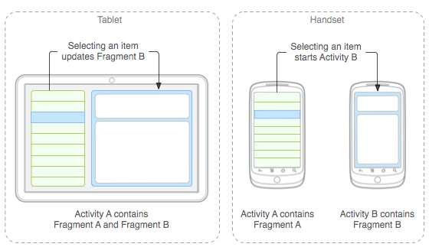
Fragments for Adaptive UIs
Large screen: Fragments can be loaded side-by-side in one activity
Small screen: Fragments can be loaded one at a time in separate activities
Notes:
https://developer.android.com/guide/topics/ui/menus.html
In this presentation, we will only look at the first type, the options menu

Slide 5
Fragments Embedded in Activities
You can combine multiple fragments in a single activity to build a multi-pane UI
You can reuse one or more fragments in multiple activities.
A fragment:
has its own lifecycle
receives its own input events
can be added or removed while the activity is running
A fragment must always be embedded in an activity
the fragment's lifecycle is directly affected by the host activity's lifecycle
when the activity is paused, so are all fragments in it
when the activity is destroyed, so are all fragments
The fragment lives in a ViewGroup (layout) inside the activity's view hierarchy
The fragment defines its own view layout
You can insert a fragment into your activity layout by:
Declaring the fragment in the activity's layout file, as a <fragment> element,
Or from your application code by adding it to an existing ViewGroup.
Notes:
https://developer.android.com/guide/components/fragments.html
Note: a fragment is not required to be a part of the activity layout; you may also use a fragment without its own UI as an invisible worker for the activity.

Slide 6
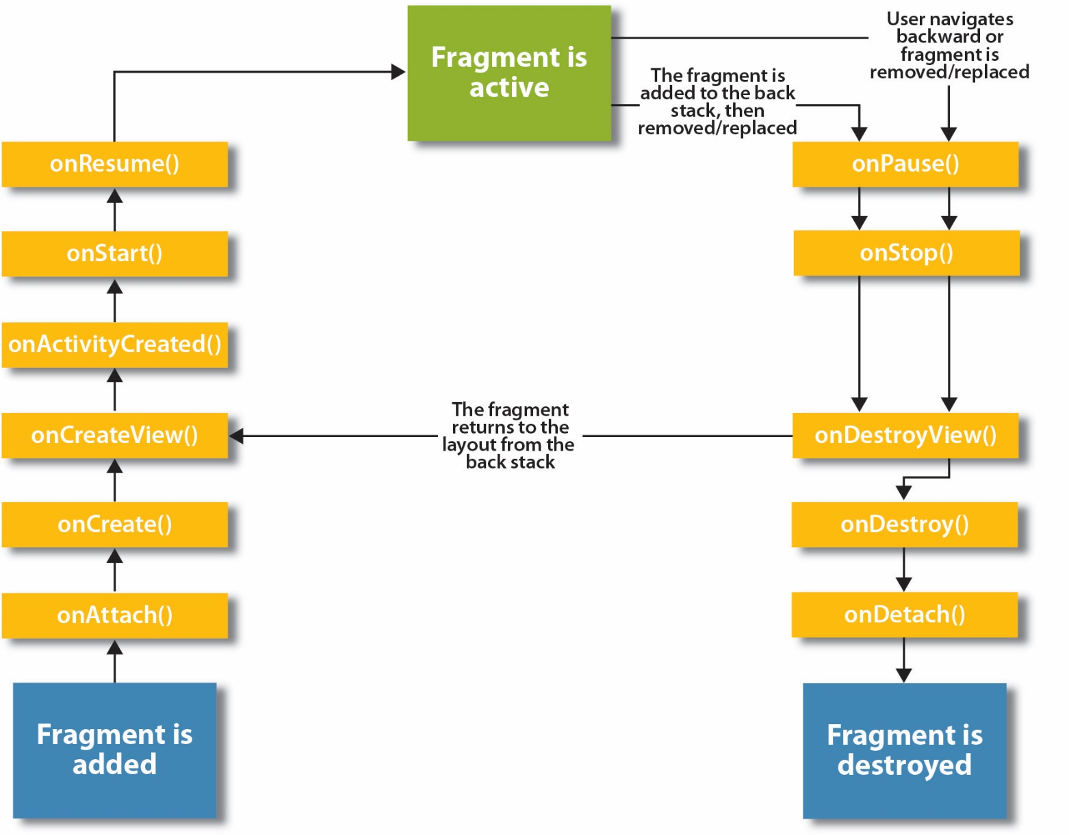

Slide 7
Declaring a Fragment
An app will use fragments that are subclasses of Fragment
The Fragment’s UI can be declared in AXML or programmatically
Fragment UIs are declared just like Activity UIs

Slide 8
Loading a Fragment
Fragments are loaded into an Activity at runtime
The Fragment to load can be determined programmatically by the Activity’s C# code
Or the Fragment’s name can be hard-coded into the AXML loaded by the Activity

Slide 9
Small Screen
Each activity loads a single fragment
Activity AXML layout: instantiates a Fragment object
Fragment object: inflates fragment AXML UI layout
Fragment AXML UI layout is displayed by the activity
Activity: loads an AXML layout

Slide 10
Large Screen
Activity: loads an AXML layout
AXML layout: instantiates two Fragment objects
Fragment object: inflates AXML UI layout
Fragment object: inflates AXML UI layout
AXML UI layout is displayed by the activity
AXML UI layout is displayed by the activity

Slide 11
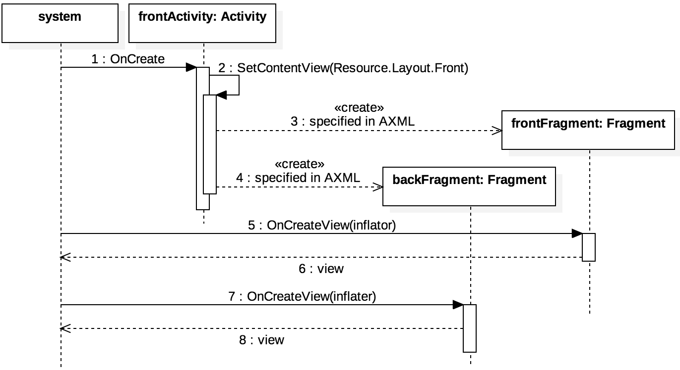
Large Screen Sequence

Slide 14



Fragment Example
Using the Rock, Paper, Scissors Game

Slide 15
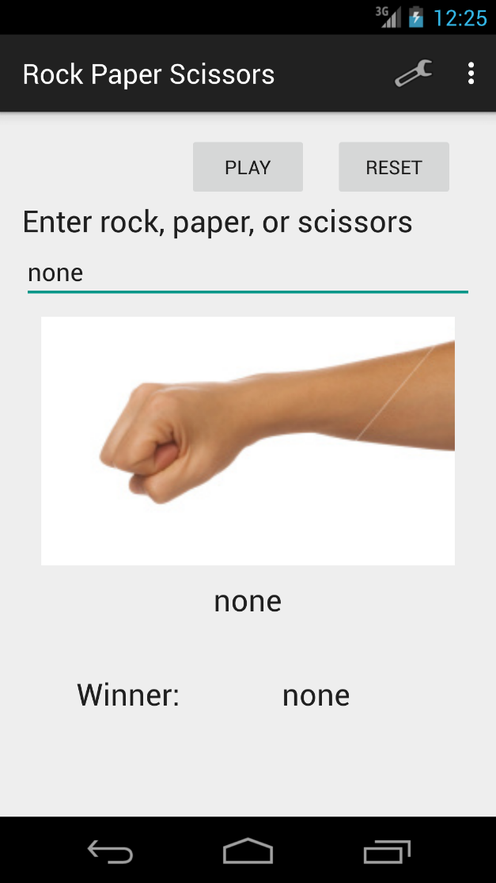
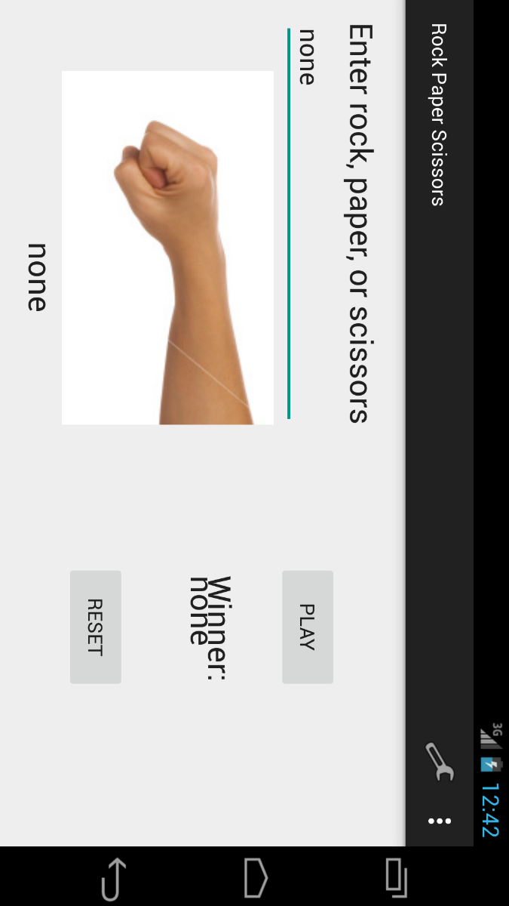
Non-Fragment RPS Game UI

Slide 16
Files in the Non-Fragment RPS Game Example
The files we are interested in are the ones that will be modified when we refactor our app to use fragments:
MainActivity.java
activity_main.xml
activity_main.xml (land)
preferences.xml

Slide 17
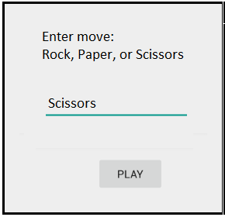
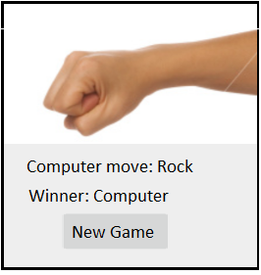
Planned Layout: Small Screen with Fragments
First Screen
Second Screen

Slide 18
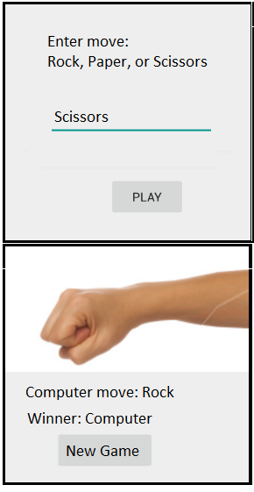
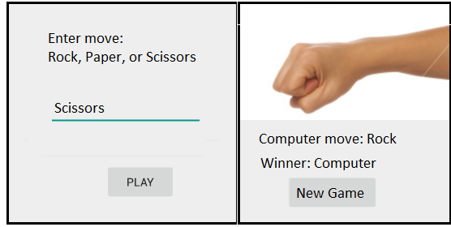
Planned Layout: Large Screen with fragments
Landscape
Portrait

Slide 19
New Files for the Fragment Version
These are the new files for the game UI that will be added to the project to implement fragments
Java classes: FirstActivity SecondActivity FirstFragment SecondFragment | XML Layout Files: first_activity second_activity first_activity (large-port) first_activity (large-land) First_fragment Second_fragment

Slide 20
Step 1: Implement Activities & Fragments for Small Screens
Our goals for this step are:
The FirstFragment is displayed in the FirstActivity when the app loads
The SecondFragment is displayed in the SecondActivity when a user clicks the “Play” button.
The FirstFragment is displayed again when a user clicks the “New Game” button.

Slide 21
Modify the Manifest for the New Activities
Change the name of the main activity (the one that is launched when the app starts): <activity android:name="edu.uoregon.bbird.rps.FirstActivity“ android:launchMode="singleInstance"
Add the second activity: <activity android:name="edu.uoregon.bbird.rps.SecondActivity“ android:label=“Computer Move“ android:launchMode="singleInstance" android:parentActivityName="edu.uoregon.bbird.rps.FirstActivity" > </activity>
Notes:
If you create a new activity using the New, Activity menu in Android studio, it will automatically create a layout xml file and add an <Activity> element to the manifest

Slide 22
Loading sequence- small screen
FirstActivity, onCreate, loads first_activity.xml (single pane layout) setContentView(R.layout.first_activity);
first_activity, triggers automatic calls to FirstFragment methods <fragment android:name="edu.uoregon.bbird.rps.FirstFragment"
FirstFragment, onCreateView, loads first_fragment.xml View view = inflater.inflate(R.layout.first_fragment, container, false);

Slide 23
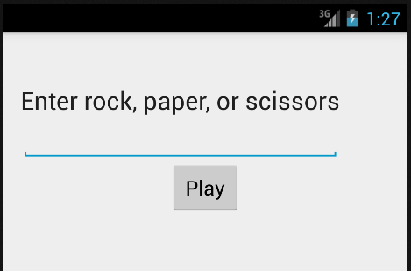
Test it!
Run the app. You should see the first fragment displayed on the opening screen:

Slide 24
Launching the Second Activity- Small Screen
Clicking the Play button starts the SecondActivity startActivity(new Intent(getActivity(), SecondActivity.class));
SecondActivity, onCreate, loads second_activity.xml (single pane layout) setContentView(R.layout.second_activity);
second_activity, triggers automatic calls to SecondFragment methods <fragment android:name="edu.uoregon.bbird.rps.SecondFragment"
SecondFragment, onCreateView, loads second_fragment.xml View view = inflater.inflate(R.layout.second_fragment, container, false);

Slide 25
Event Handler for the Play Button
In the FirstFragment class:
@Override public View onCreateView(LayoutInflater inflater, ViewGroup container, Bundle savedInstanceState) { View view = inflater.inflate(R.layout.first_fragment, container, false); // Set this fragment to listen for the Play button's click event Button b = (Button) view.findViewById(R.id.playButton); b.setOnClickListener(this); return view; } @Override public void onClick(View v) { startActivity(new Intent(getActivity(), SecondActivity.class));
}
}

Slide 26
Event Handler for the New Game Button
Deprecated: Use an up button instead
In the SecondFragment class:
@Override public View onCreateView(LayoutInflater inflater, ViewGroup container, Bundle savedInstanceState) { View view = inflater.inflate(R.layout.second_fragment, container, false); // Set this fragment to listen for the New Game button's click event Button b = (Button) view.findViewById(R.id.newGameButton); b.setOnClickListener(this); return view; } @Override public void onClick(View v) { startActivity(new Intent(getActivity(), FirstActivity.class));
}
}

Slide 27
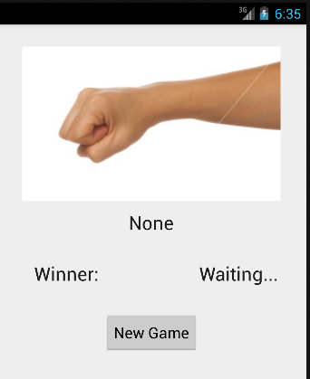
Test it!
Run the app. Click the “Play” button. You should see the second fragment displayed.
Click the “New Game” button. You should see the first fragment again.

Slide 28
Step 2: Instantiate a Game object and Connect it for use with a Small Screen.
Our goal for this step is to implement the game-play logic:
The user can enter their choice (rock, paper, or scissors) on the first screen.
When the user clicks the “Play” button the second screen is shown where the computer’s choice and the winner are displayed.
When the user clicks the “New Game” button the first screen is displayed again.
Note: on a device with a small screen, the Game class will be instantiated in the 2nd Activity.

Slide 29
Overview of New Code Required (Much of it isn’t “new”, we can copy it from the non-fragment version)
FirstActivity: nothing new
FirstFragment, in onClick for the “Play” button:
Get the player’s choice (rock, paper, or scissors) from rpsEditText, add it to the intent that will be sent to the SecondActivity.
SecondActivity
onResume: get the player’s choice out of the intent, put it in a RpsGame object, and pass it to the SecondFragment by calling ComputerMove(game).
onNewIntent: we need this to get new intents when our Activity is resumed.
SecondFragment
ComputerMove: This new method contains essentially the same code that was in the Play method of the single Activity version of the game.

Slide 30
Step 3: Implement Persistence and Settings for Devices with a Small Screen.
Our goal for this step is to:
The state of the game, as shown by the SecondActivity, will be preserved when the device is rotated or anything else happens to cause the Activity to be destroyed and recreated.
The user can click on the menu on the FirstActivity to bring up the settings (preferences) screen and set any of the settings.
Any settings that are changed will take effect as soon as the user uses the back button to navigate back to the first sceen.
Note: Settings will now work for both small and large screen devices.

Slide 31
Step 4: Implement Activities & Fragments for Large Screens
Our goals for this step are:
In portrait orientation, both the first and second fragments will be displayed one above the other.
In landscape orientation, both the first and second fragments will be displayed side-by-side.
An instance of the Game class will be instantiated in the FirstActivity and gameplay logic is “hooked up” so the game can be played
Persistence is implemented so the game state is restored when the FirstActivity is resumed.

Slide 32
Loading the fragments
In first_activity.xml (large-port):
a
Add a vertical linear layout that contains two fragment elements with the names:
FirstFragment
SecondFragment
Give each fragment a weight=“1”, width=“0dp”, and height=“match_parent”
In second_activity.xml (large-land):
Add a horizontal linear layout that contains two fragment elements with the same names as the one’s above.
Give each fragment a weight=“1”, width=“match_parent”, and height=“0dp”

Slide 33
Instantiate a Game Object and Make it’s State Persistent
In FirstActivity:
Add an instance variable to hold a reference to a game object.
Write a setter for it. The setter will pass the game object to the SecondFragment.
In FirstFragment:
In OnActivityCreated:
Create a new instance of the game object.
If the game’s state has been saved, create the object using values from SavedInstanceState.
Otherwise, just create an object with default values.
Call the setter on FirstActivity to pass it a reference to the game object.
In OnSaveInstanceState:
Save the value stored in the game object for the humanHand outState.putInt("humanHand", game.getHumanHand().ordinal());
Save the value stored in the game object for the ComptuerHand (Nearly the same code as above)

Slide 34
Hook up the Game Object
In FirstActivity, add a method named makeComputerMove that calls game.computerMove().
In FirstFragment:
Add an instance variable for keeping track of whether the single-pane or two-pane layout is loaded.
In OnActivityCreated: Add a line of code to detect which layout was loaded twoPaneLayout = activity.findViewById(R.id.second_fragment) != null;
In FirstFragment, OnClick:
Get input from rpsEditText and use it to set humanHand on the game object.
Call makeComputerMove in the FirstActivity

Slide 35
Implementing Persistence
We only need to save state for SecondFragment, but we’re handling persistence for both fragments in FirstFrament since there are complications with SecondFragment’s persistence when it is loaded in a single-pane layout.
In FirstFragment:
In OnActivityCreated, restore state to the game object from savedInstanceState, then pass the game object to the host Activity, which will in turn pass it to SecondFragment.
In OnSaveInstanceState, save the state of the game.
In FirstActivity, detect whether SecondFragment is loaded and only call methods on SecondFragment if it exists.

Slide 36
References
Documentation from Android Developers
API Guide: Fragments http://developer.android.com/guide/components/fragments.html
API Guide: Supporting Multiple Screens http://developer.android.com/guide/practices/screens_support.html
Reference: Activity http://developer.android.com/reference/android/app/Activity.html
Reference: Intent http://developer.android.com/reference/android/content/Intent.html

